Slide 1
An INTRODUCTION TO ARDUINO by rajesh

Slide 2
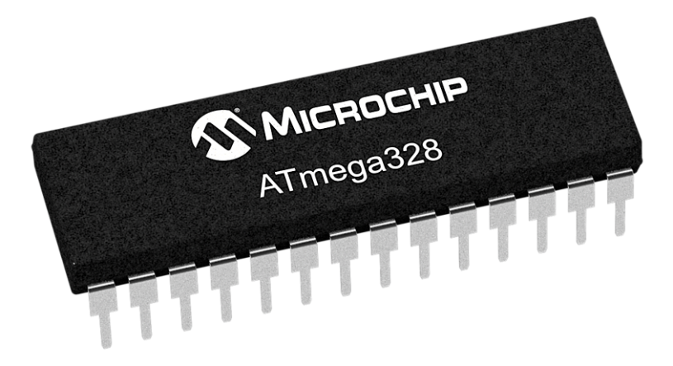
What is a microcontroller ?

Slide 3
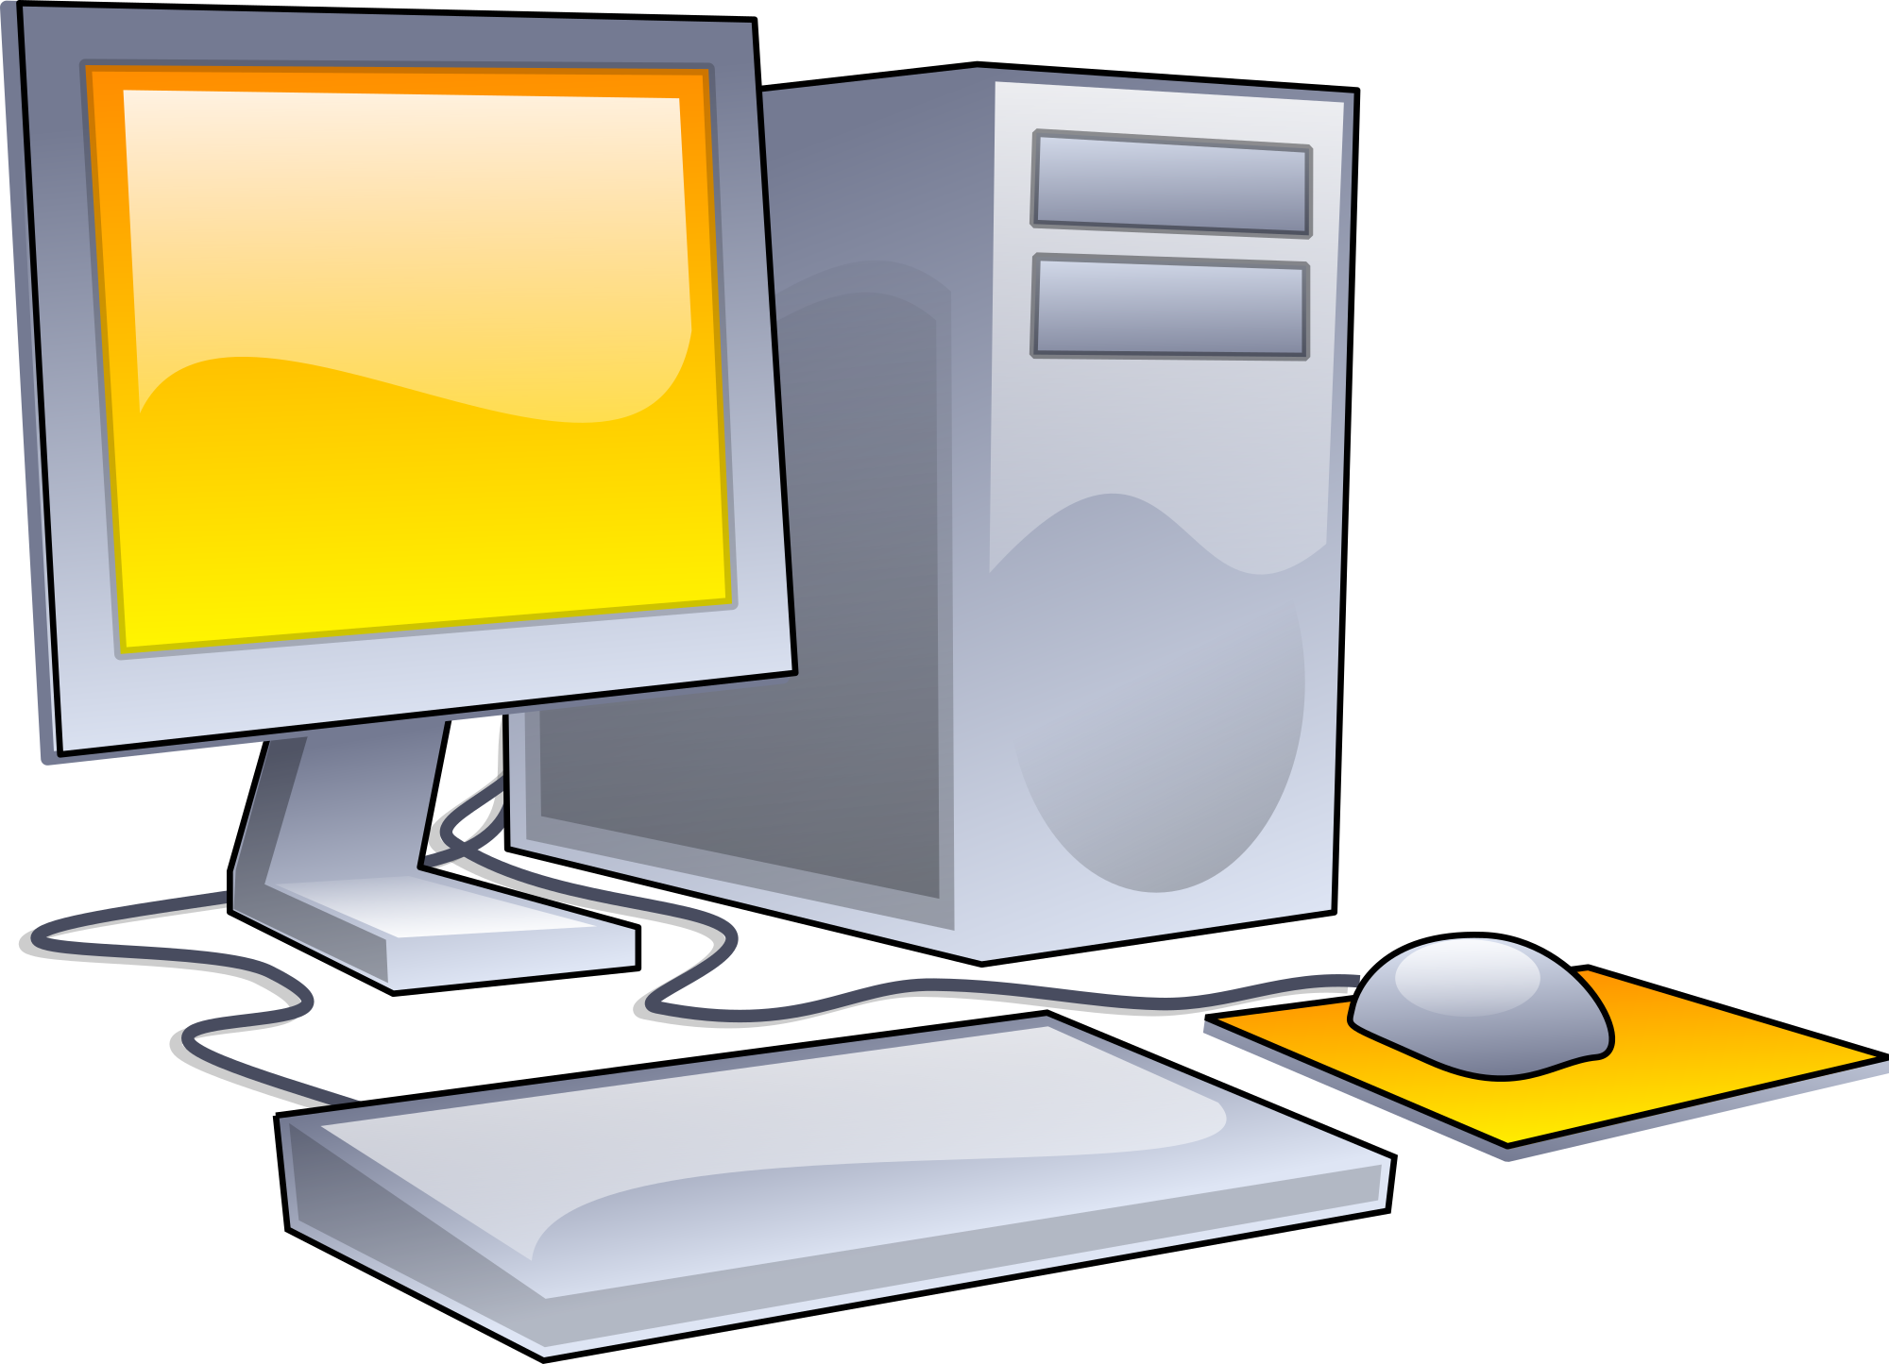
What is a computer ?

Slide 4
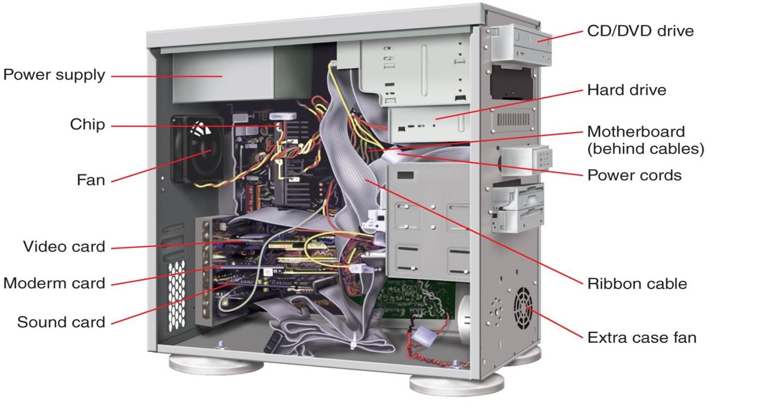
C.P.U

Slide 5
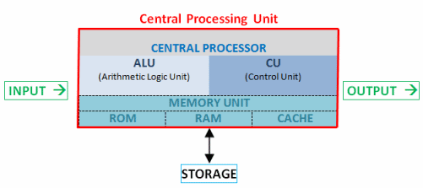
Block diagram of c.p.u

Slide 6
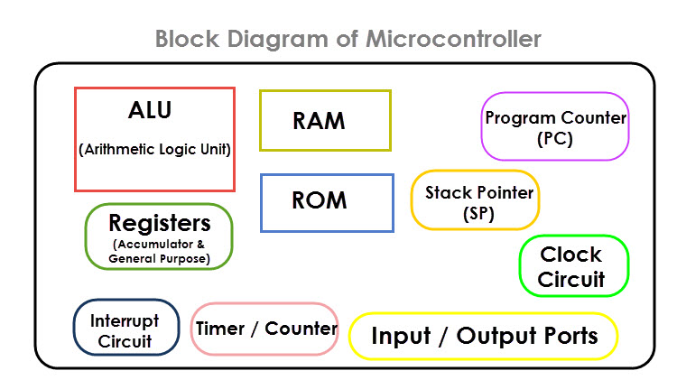
System on a chip (soc)

Slide 7
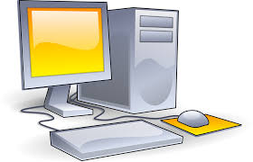
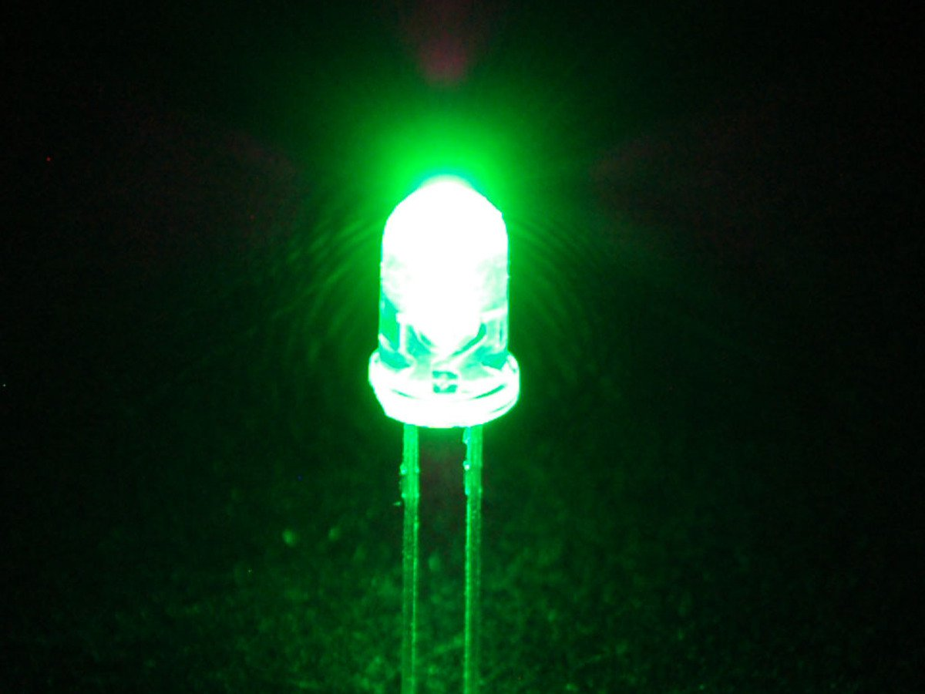
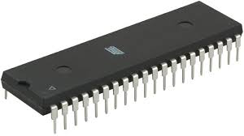
Why cant we use a computer ?
Micro-processors are for general purpose (can add resources like RAM,ROM etc based on user requirement)
Micro-controllers are for specific applications with limited resources

Slide 8
What is the Need of a micro controller ?
1.can you toggle a switch 100 times in a second?
2.can you do a repetitive task 24X7

Slide 9
Arduino
Arduino is a prototype platform (open-source) based on an easy-to-use hardware and software. It consists of a circuit board, which can be programed (referred to as a microcontroller) and a ready-made software called Arduino IDE (Integrated Development Environment), which is used to write and upload the computer code to the physical board.
The key features are −
Arduino boards are able to read analog or digital input signals from different sensors and turn it into an output such as activating a motor, turning LED on/off, connect to the cloud and many other actions.

Slide 10
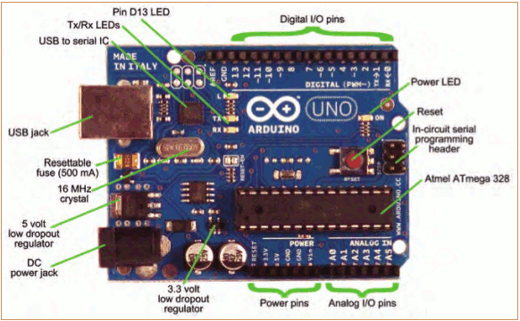
Arduino Board description

Slide 11
Getting Started
Download & install the Arduino IDE
Connect the board to your computer via the USB cable
If needed, install the drivers
Launch the Arduino IDE
Select your board
Select your serial port
Open the blink example
Upload the program

Slide 12
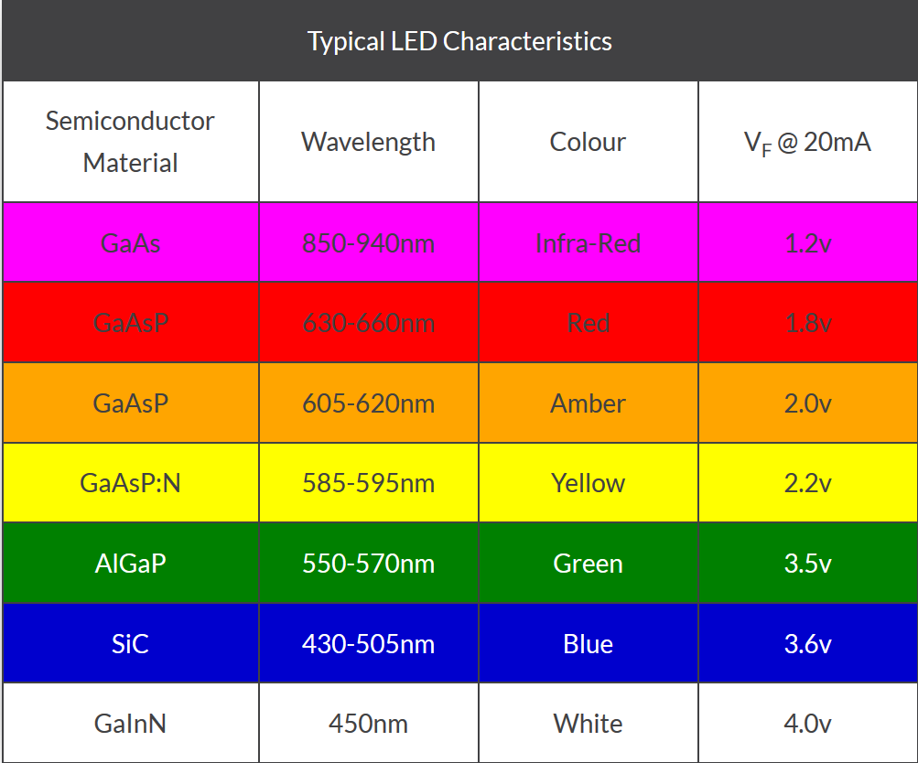

Slide 13
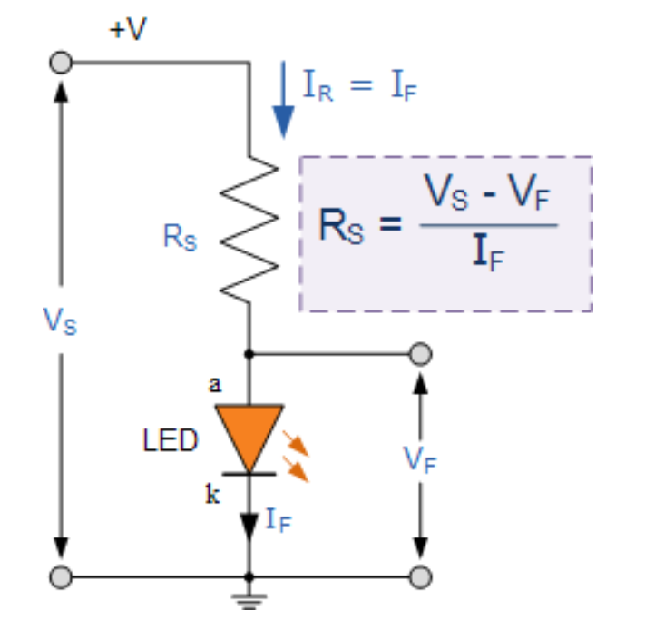
Led series resistor calculation

Slide 14
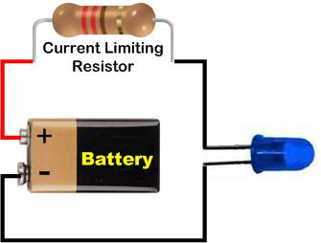

Slide 15
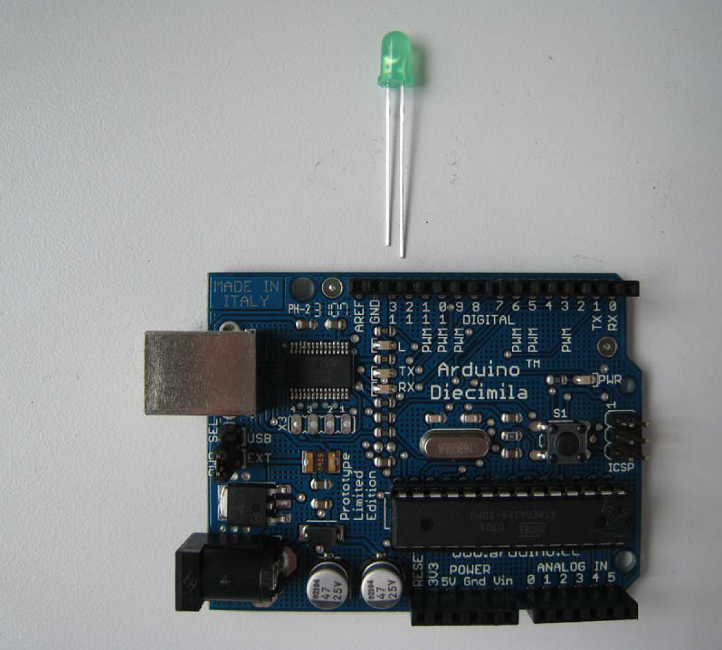

Slide 16
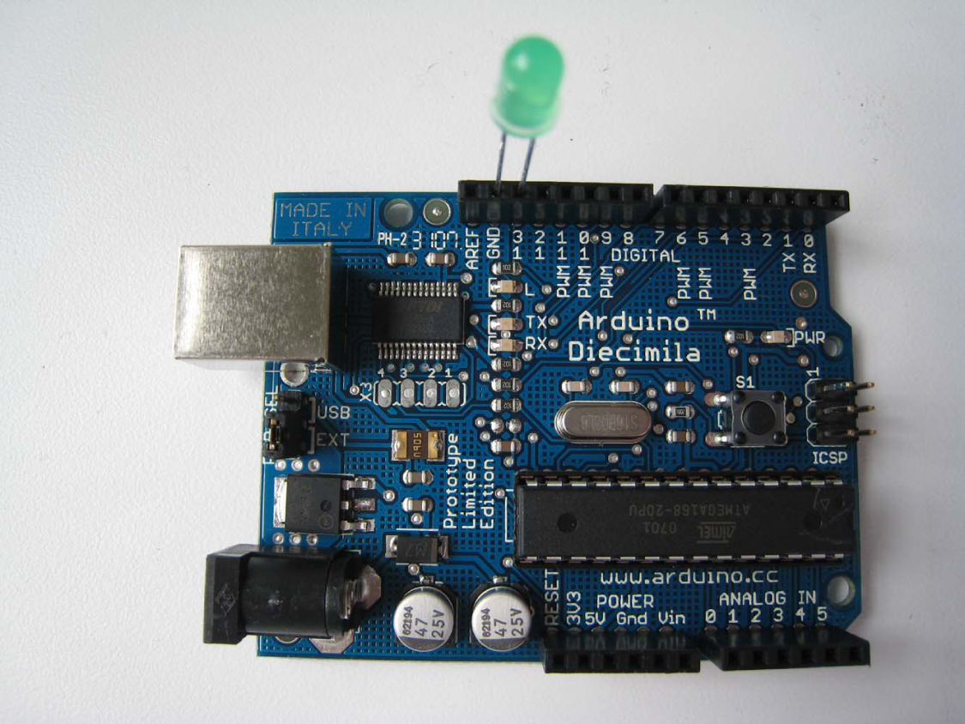

Slide 17
precautions
Power supply
Do not Short circuit any digital pin with the ground pin

